Slide 1
What’s New and What’s Coming…
The ever-evolving data platform
Andy Roberts Data Platform Architect Microsoft

Slide 2
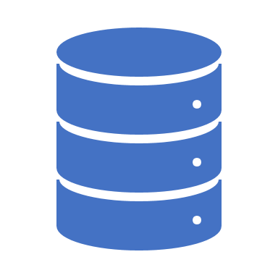
Transactional
SQL Server 2019
Azure SQL Database Managed Instance
Azure SQL Database Hyperscale DB
Azure SQL Database for MariaDB

Slide 3
SQL Server 2019 big data, analytics, and AI
Data virtualization
Managed SQL Server, Spark, and data lake
Complete AI platform
Admin portal and management services
Integrated AD-based security
Analytics
T-SQL
Apps
REST API containers for models
SQL Server External Tables
SQL Server
Spark
SQL Server
ML Services
Spark & Spark ML
Compute pools and data pools
Scalable, shared storage (HDFS)
Open database connectivity
NoSQL
Relational databases
HDFS
External data sources
HDFS
Combine data from many sources without moving or replicating it
Scale out compute and caching to boost performance
Store high volume data in a data lake and access it easily using either SQL or Spark
Management services, admin portal, and integrated security make it all easy to manage
Easily feed integrated data from many sources to your model training
Ingest and prep data and then train, store, and operationalize your models all in one system

Slide 4
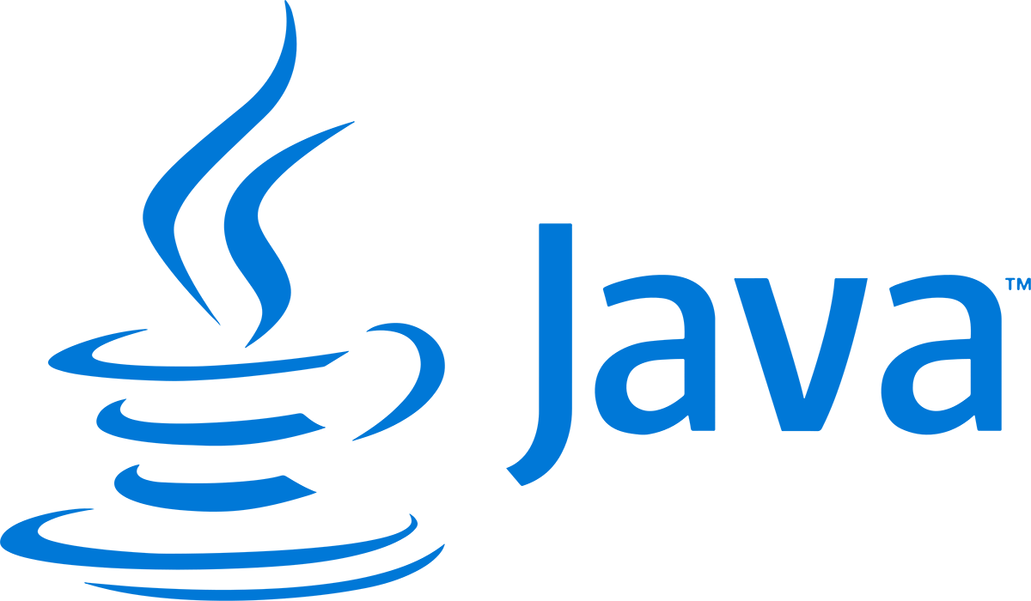
Enhancing the developer experience
Extend T-SQL with R, Python, and Java
Satellite
R
SQL Graph enhancements
UTF-8 support
Machine Learning Services enhancements
SQL Server Java extension
SQL Server
T-SQL
Direct communications for performance
Launch pad

Slide 5
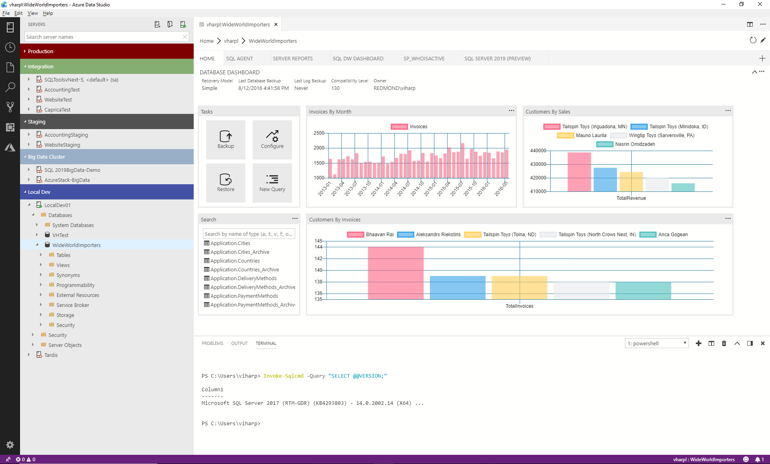
The Azure Data Studio tools experience
Azure Data Studio is a lightweight, open source, cross-platform graphical management tool and code editor
Enable a modern DevOps experience for database developers and DBAs on their platform of choice​
Simplify development, configuration, management, monitoring and troubleshooting for SQL databases on-premises and in the cloud^{NEW}
Use SQL Server Management Studio 18.0 Preview to access, configure, manage, and administer all SQL Server components

Slide 6
Investments in the future of SQL Server
SQL Server on Edge
Finish features for big data clusters and data virtualization
Making SQL Server more available, faster
Further enhance SQL Server security
Enhance the engine to align with hardware innovation
Continue to make the container experience great
Engine improvements based on customer feedback

Slide 7
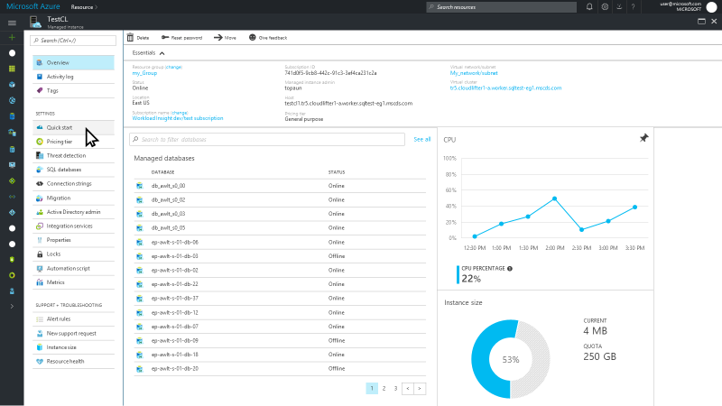
Azure SQL Database Managed Instance
GA*
Released @ Ignite
September 2018
A new deployment option that brings native VNET support and expanded instance-level surface area compatible with existing SQL Server
Exposes Server Instance and provides instance-scoped capabilities
Streamlines ‘lift and shift’ to SQL Database
Supports VNET isolation with private IPs
Use your existing SQL licenses with the Azure Hybrid Benefit for SQL Server
Delivers all the benefits of SQL Database – HA built-in, failover, Geo-DR, intelligence
Works with new Azure Database Migration Service
Learn more.
*Managed Instance available with two options: General Purpose and Business Critical.
General Purpose GA October CY2018*
Business Critical GA ETA Q4 CY2018.
Managed Instance will be initially available in the following regions: Australia East, Australia Southeast, Canada Central, Central US, East Asia, East US, France Central, Japan East, Japan West, Korea Central, Korea South, North Central US, North Europe, South Central US, South India, Southeast Asia, UK West, West Europe, West US 2
Notes:
Azure SQL Database Managed Instance is a new deployment option in SQL Database that provides SQL Server compatibility and native virtual network (VNET) support. Managed Instance will be available in all regions where SQL Database is available, with availability in sovereign clouds by GA.
Customers can now move their SQL Server workloads to an intelligent, fully-managed service without rearchitecting their apps and leverage the new vCore-based performance tiers for easy translation of on-premises requirements to the cloud. They can also maximize their on-premises license investments for savings of up to 30% on Managed Instance with Azure Hybrid Benefit for SQL Server.
Managed Instance will be initially available in the following regions: Canada Central, Canada East, Central US, East Asia, East US, East US 2, Japan East, Korea Central, Korea South, North Central US, North Europe, South Central US, South India, Southeast Asia, UK South, West Central US, West Europe, West India, West US, West US 2. By GA, the list will be expanded to all public regions where SQL Database is available, with availability in sovereign clouds as well.

Slide 8
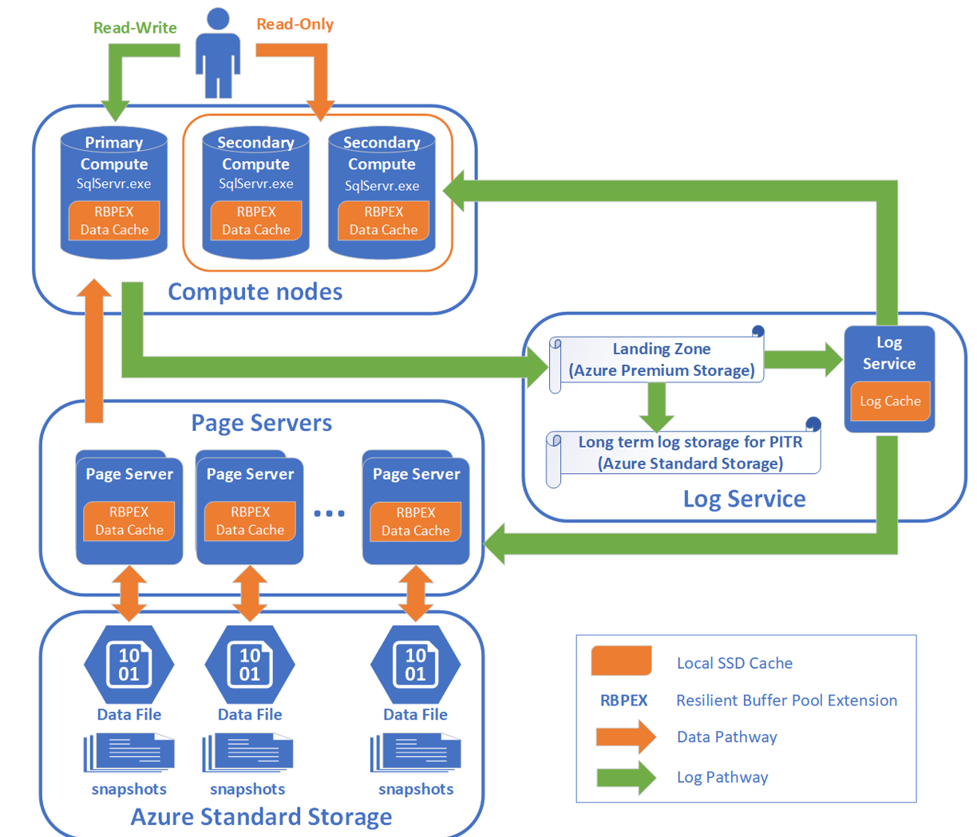
Azure SQL Hyperscale Database

Slide 9
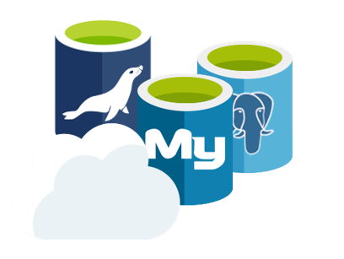
Azure Database for MySQL, PostgreSQL, and MariaDB
GA
Released
December 2018
Azure databases for MySQL, PostgreSQL, and MariaDB offer enterprise-ready and fully-managed community versions of the popular OSS databases.
Azure Database for MariaDB - Going GA December 4, 2018
Open source developers now have more choices and can use the benefits of a fully managed MariaDB on the Azure platform backed with enterprise-grade security, and industry leading 99.99% availability
Microsoft is also a proud platinum sponsor of the MariaDB foundation, working to promote continuity and open collaboration in the MariaDB community
Learn more about MySQL
Learn more about PostgreSQL
Learn more about MariaDB
Notes:
Talking points:
Microsoft is investing in the open source communities for databases to bring enterprise-ready features to community editions of MySQL, PostgreSQL, and MariaDB
With the addition of Read Replica, we have now brought a popular and wanted feature for MySQL to be supported by Azure which will enable strong reliability and dependency of your apps
Moving servers across subscriptions will enable greater flexibility of our customers

Slide 10
Data Warehouse
Azure Data Warehouse Gen2
Snowflake

Slide 11
Azure DW Compute Optimized Gen 1
Cores
Memory
Control
SSD Tempdb
Cores
Memory
Cores
Memory
Cores
Memory
Compute
Cores
Memory
SSD Tempdb
SSD Tempdb
SSD Tempdb
SSD Tempdb
Remote Storage
Snapshot backups
Data
Log
Notes:
Formerly known as optimized for elasticity

Slide 12
Azure DW Compute Optimized Gen 2
Cores
Memory
Cores
Memory
Cores
Memory
Compute
NVMe SSD
NVMe SSD
NVMe SSD
Cache
Tempdb
Cache
Tempdb
Cache
Tempdb
Remote Storage
Snapshot backups
Data
Log
Notes:
Formerly known as Optimized for compute

Slide 13
Data Movement
Azure Data Factory v2
Azure Data Factory Data Flows

Slide 14




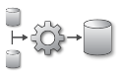

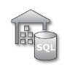


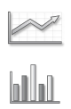

Azure data factory
Modernize your enterprise data warehouse at scale
Integrate via Azure Data Factory
LOB
INGEST
STORE
PREP & TRANSFORM
MODEL & SERVE
Cloud
CRM
Graph
Azure Analysis Services
Image
VNet
Social
Data orchestration, scheduling and monitoring
Azure Data Lake Azure Storage
Data Transformations
Machine Learning
Azure SQL DW,
HDInsight, Data Lakes
Apps and Insights
IoT
On-premise

Slide 15
ADF V2 Improvements
Integration Runtimes (IR) replace DMG, provide data movement and activity dispatch on-prem or in the cloud
Supports resources within virtual networks
Integration Runtime includes SSIS option to lift & shift SSIS packages to the Cloud
Separation of “control flow” & “data flow” capabilities for more flexible pipeline management
Looping, conditionals, dependencies, parameters
Python SDK
Built-in Source Control Support
On-Demand Spark support
Transform data in Azure Databricks
Flexible pipeline scheduling with wall-clock, tumbling windows and triggered executions
Expanded use cases: From primarily time window-oriented pipelines, to trigger-based on-demand for more flexible ETL and data integration orchestrations
Graphical UI pipeline builder for a code-free experience

Slide 16
Analytics
Azure Databricks
Azure Machine Learning
Azure Data Lake Store Gen 2

Slide 17
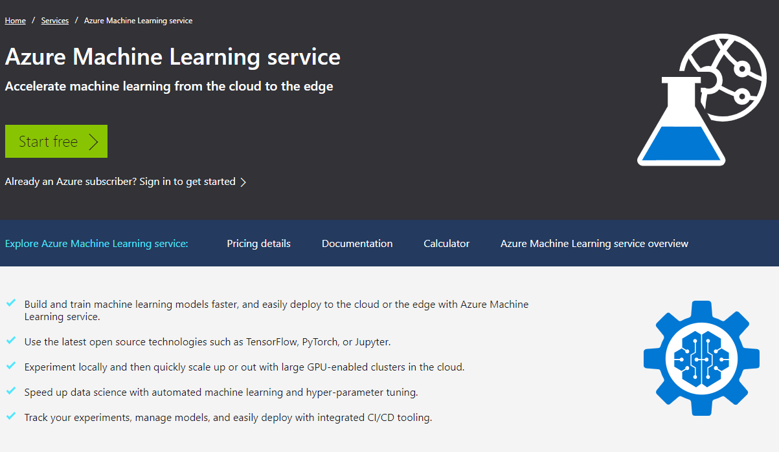
Azure Machine Learning service
GA
Released @ Connect()
December 2018
Azure Machine Learning service is a cloud service that enables data scientists to quickly and easily build, train, and deploy machine learning models. We’re announcing new features in Azure Machine Learning service (in public preview):
Automated machine learning: Identify the best models faster with model selection and intelligent hyper-parameter tuning
Azure Machine Learning service Python SDK: Integrate with your favorite Python development environment, including Visual Studio Code, Visual Studio, PyCharm, Azure Databricks notebooks, or Jupyter notebooks.
Distributed deep learning: Build better models faster with massive, managed GPU clusters. Train models quickly with distributed deep learning, and deploy them on GPUs and FPGAs.
Model management: Manage your Dockerized models using models and images registry, and integrate into your continuous integration (CI/CD) pipeline.
Hardware accelerated inferencing: Access powerful FPGAs for high speed image classification and recognition scenarios. Supported models include ResNet 50, ResNet 152, VGG-16, SSD-VGG, and DenseNet-121 that can be trained using your data.
To learn more about Azure Machine Learning service, read the Ignite Blog.
Notes:
.

Slide 18


Evolving Data Lake Strategy
Past
Present
Future
WASB
WASB
ADLS
Azure Data Lake Storage Gen2
Blob Storage + (WASB)
Blob Storage + (WASB)
Azure Data Lake Store (ADLS)
Scalable, secure storage that speeds time to insight
Scale and Availability
Scale and Availability
Speed to Insight
Scale and Availability
Speed to Insight
Cost Effectiveness
Cost Effectiveness
Rich Security
Cost Effectiveness
Rich Security
Azure Data Lake Storage Gen2: Single Data Lake Store that combines the performance and innovation of ADLS with the scale and rich feature set of Blob Storage

Slide 19
Azure Data Lake Storage Gen2 Key Features
Hadoop Compatible File System Interface for Blob Storage
Atomic file and folder operations (faster job execution, and fewer transactions)
Fine grained ACLs (File and Folder permissions)
Limitless storage (Azure Storage account enhancements)
Pricing based on the Azure Blob Storage pricing model
Availability in all Azure regions at GA
Optimized for Hadoop and Spark analytic engines

